Slide 1
oVERCOMING
“Do not be overcome by evil, but overcome evil with good.”
Romans 12:21

Slide 2
Christians should be the primary source of Love and Compassion in the world
Romans 12:9 Let love be without hypocrisy.
1 Timothy 1:5 The goal of our instruction is love from a pure heart and a good conscience and a sincere faith.
Colossians 3:14 Above all, clothe yourselves with love
Notes:
1st C Xians = Marked by Love/Compassion

Slide 3
Christians should be the primary source of Love and Compassion in the world
“Predestination”
5th Avenue
The Other Side
Notes:
“Predest” = Institut. Xianity→ Supporting Horrific Suffering
** 5th Ave / Other Side = Suffering Masses
Institut. Xianity in Europe = COMMUNISM
Marx: “Opiate of the masses…”

Slide 4
Christians should be the primary source of Love and Compassion in the world
Authentic Christianity
Across the Globe
Historically

Slide 5
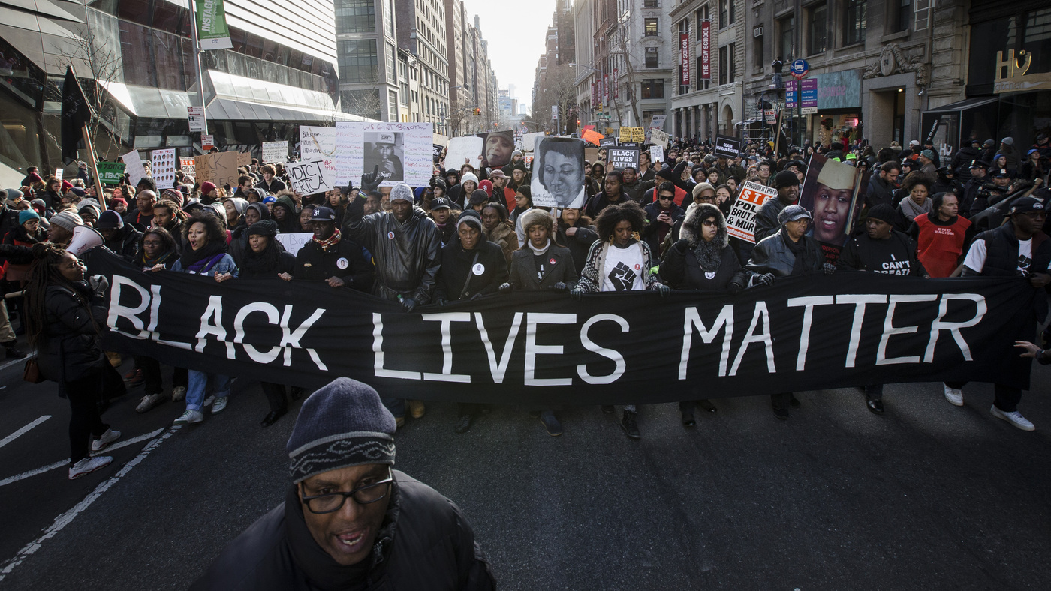

Christians should be the primary source of Love and Compassion in the world
Secular World Can’t Do It
“Peace!”
“Justice!”
Reality
Notes:
Secular World → ** Peace **Justice **Reality
= **Continues Today ** ~Justice/Peace

Slide 6
Christians should be the primary source of Love and Compassion in the world
Relationship With God (12:1)
… With Others (12:10-11)
Be devoted to one another in brotherly love…serving the Lord;
Present your bodies a living and holy sacrifice, acceptable to God…

Slide 7
Christians should be the primary source of Love and Compassion in the world
“Love must be sincere”
With Believers
With Everyone
12:14-21
12:10-13
Notes:
**“Love…sincere” = **2 Realms…
Rom.12 2Nite → G. Separates FAKE From REAL

Slide 8
“Love Must Be Sincere”
Sincere Love
Zealous, diligent
Despite setbacks
PRAYER POWER
…not lagging behind in diligence, fervent in spirit, serving the Lord; rejoicing in hope,
persevering in tribulation
devoted to prayer, contributing to the needs of the saints
Romans 12:11-13

Slide 9
“Love Must Be Sincere”
…pursuing hospitality.
Romans 12:13
Φιλοξενία
“Love of strangers”
Government
Christian
India Gospel League
Notes:
Hospitality = **Philoxenos = OUTSIDERS
We Depend on the Gov’t 2 Care 2 MUCH
**Gov’t=OK/Necess **Xians=PERM Help
IGL = “Pursuing hospitality”

Slide 10
Christian Love in the World
…pursuing hospitality. Bless those who persecute you; bless and do not curse.
Romans 12:14
Salt & Light (Matthew 5:13-14)
“You are the salt of the earth; but if the salt has become tasteless… it is no longer good for anything, except to be thrown out and trampled under foot by men.
“You are the light of the world. A city set on a hill cannot be hidden;
Notes:
Xian Luv in World = Whole New Game, ~Like in BOC
“Bless..~Curse” → ~Mean ~Fight → **Mt.5:13=FIGHTERS
JC/Paul/Peter/all 1st C Xians=Paid Price 2b Salt/Light

Slide 11
Christian Love in the World
Rejoice with those who rejoice, and weep with those who weep.
Romans 12:15
Love Means Emotional Investment
Paying a Personal Price
“Rejoice” rather than Jealousy
Notes:
Love = **INVEST→ PERSONAL =
= **Paying a PRICE = BROKEN HEARTS!
Persecut = HURTS when U Luv!
** Fighting the Flesh

Slide 12
Christian Love in the World
Be of the same mind toward one another;
do not be haughty in mind, but associate with the lowly.
Romans 12:16
Backwards Wisdom
Cannot impose Christian values on the World
“Body Life” becomes “Salt & Light”
Notes:
**Backwards Wisdom = “Haughty…Wise…”
NOBODY Likes a PRICK → they PRETEND to
** ~Impose → WS “Game” = “I’m COOL/Tuff/Pwrful”
** BUT: Body Life→Salt: PRACTICING KINDNESS
=Src of Hospitals/Orphanages/Social Concerns
=Kindness ~PRESENT b4 Xianity

Slide 13
Christian Love in the World
Do not be wise in your own estimation.
Romans 12:16
Learned in Body Life (Romans 12:3)
Don’t think more highly of himself than you ought to think;
but to think so as to have sane judgment, as God has allotted to each a measure of faith.
Notes:
“I’m WISE” = Src. Of Alienation/Jealousy/Fights
= Office Politics
AP: U hv GOD on Ur Side → ~Need 2b Jealous!
**Learn in BOC 1st → Salt/Light in WS

Slide 14
Christian Love in the World
If possible, so far as it depends on you, be at peace with all men. Romans 12:18
Salt & Light Means
"Blessed are the peacemakers, for they shall be called sons of God. Matthew 5:9
…His name will be called Wonderful Counselor, Mighty God, Eternal Father, Prince of Peace. Isaiah 9:6
"He who is not with Me is against Me; and he who does not gather with Me, scatters.” Luke 11:23
Notes:
@Peace = “…depends on U” → ~DRAFT-DOGERS
“My Gov’t Enemies aren’t MY Enemies”
**Salt/Light = Mt.5:9 → R Reputation: “Sons…G” = r Legacy!!
& Is.9 JC’s Title & Eph.1:10 Mission!

Slide 15
Christian Love in the World
If possible, so far as it depends on you, be at peace with all men. Romans 12:18
Truth-Talking does not mean contentious
Some issues must be dropped
No Solution
Not Redemptive
Notes:
~Contentious → AP: Some THRIVE on Neg. Emotions
=LUV 2 Argue → STOP! B4 Someone Gets Mad!
** ~Solut → OLD, OLD Issue → Issues 2 Complex
IL: Marriage Counseling ~Go Back 20 Yrs!!
** ~Redemptv → AP: Ask“What’s the POINT??”
“?? The Value??”

Slide 16
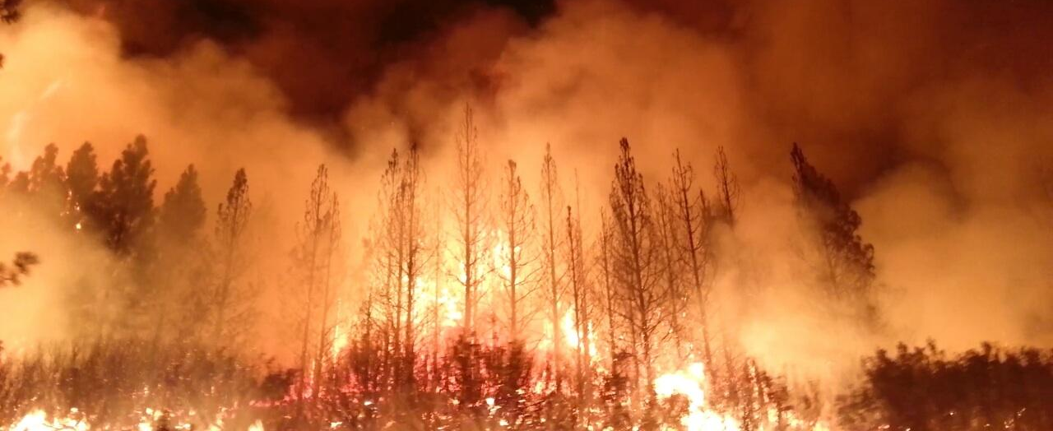
Christian Love in the World
If possible, so far as it depends on you, be at peace with all men. Romans 12:18
The tongue is a fire… it sets on fire the course of our life, and is set on fire by hell itself! James 3:6
Notes:
AP: U Hv 2b Aware of the Power of Ur Words…
ALL Fights/Wars/Divorces BEGIN w/ WORDS
IL: Put-Downs/Sarcasm = @WAR (U ~Know It)
AP: “PEACE” ~Mean Other Person Shut Up

Slide 17
Christian Love in the World
Never take your own revenge, beloved, but leave room for the wrath of God, for it is written, "Vengeance is Mine, I will repay," says the Lord.
Romans 12:19
Human Justice is Fallible
Hypocrisy
Ignorant
Often Wrong
Notes:
There’s a NEED 4 Justice
U/I ~In Any Posit. 2 Take G’s Place as Judge
** R Justice = POLLUTED →
** Hypocrisy → JC: “…w/o Sin…1st Stone” (Oldr Men 1st)
** Ignorant: ~Judge “Thoughts/Intentions…Heart”
IL: Pedophiles=Every1 Hates→ How U=React 2 Abuse?
** Wrong→ IL: 3-Strikes → IL: Les Miserables

Slide 18
Christian Love in the World
Never take your own revenge, beloved, but leave room for the wrath of God, for it is written, "Vengeance is Mine, I will repay," says the Lord.
Romans 12:19
Remember the prisoners, as though in prison with them, and those who are ill-treated, since you yourselves also are in the body. Hebrews 13:3
Notes:
AP: Nd Hearts of Compassion
JC: “Masses…w/Compassion…Sheep w/o Shepherd”
Xians=Should CARE! → No1 Else Wants 2!
“Since…in the Body” = R GREAT Advantage/Strength!
Healthy Body Life= “Forgiven Much…Loves Much”
IL: Xian Kids→ ~Undrst. How PRIVILEDGED…
AP: Parents → Teach Your Kids 2 PRACTICE MERCY

Slide 19
Christian Love in the World
Never take your own revenge, beloved, but leave room for the wrath of God, for it is written, "Vengeance is Mine, I will repay," says the Lord.
Romans 12:19
Who you gonna call?
Notes:
Call Police? YES → 2 Get a CRIMINAL off the Street!
BUT: “Salt/Light” = Reach the POOR/Underpriv.
IL: Wesley / Fox

Slide 20
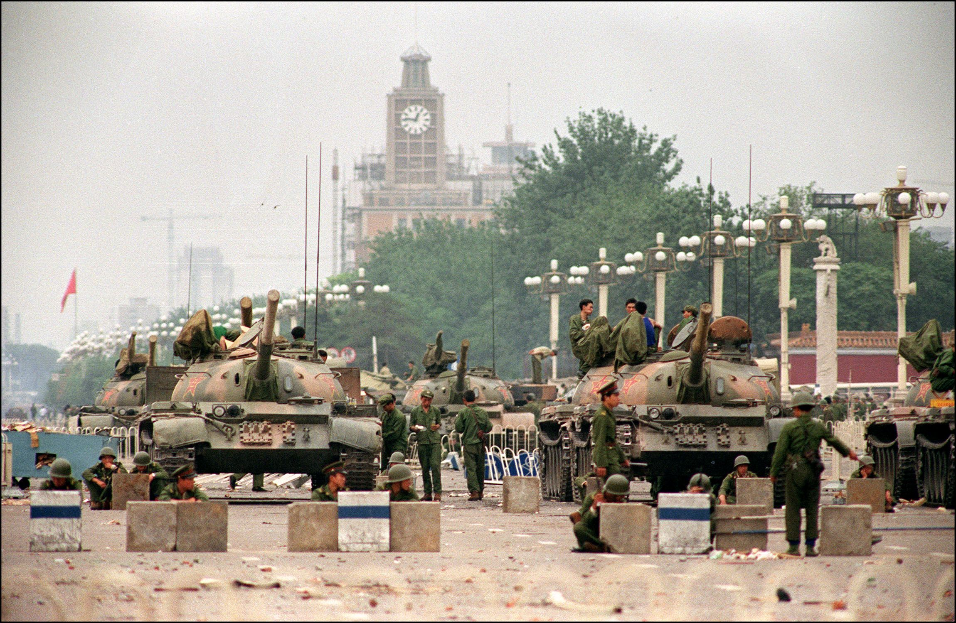
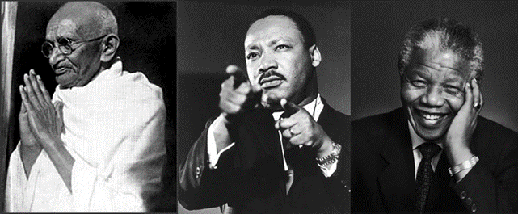
Christian Love in the World
Punish, Punish, Punish
Their feet are swift to shed blood; in their paths are ruin and misery, Romans 3:15-16
To the contrary, “if your enemy is hungry, feed him; if he is thirsty, give him something to drink; for by so doing you will heap burning coals on his head.” Romans 12:20
Results
Notes:
=REAL Revenge! → AP: Expect a BACKLASH
12:20 = THE Diff btwn JC & **Gandi/MLK/Mandella
=PUNISH “Peacefully” → Boycots/Strikes/Resistance
**RESULTS=Escalating REVENGE=Spreads like Gangrene
“Live…Sword…Die…Sword” → IL: ISIS Growth (=Kill Every1?)
IL: Ghandi / MLK =Murdered! Mandella=JAIL
**T. Square=“Peaceful Protests” = **PUNISH=W.S.Motto=Ro.3:
AP: u Can Punish Roomates/SPOUSE ~Mean U Won

Slide 21
Christian Love in the World
To the contrary, “if your enemy is hungry, feed him; if he is thirsty, give him something to drink; for by so doing you will heap burning coals on his head.” Romans 12:20
Did it work for Jesus?
YES IT DID!
Notes:
ONLY JC = Practiced This → BUT…
** ?? Wrk 4 JC?? = Why ~Hum.Gov’t/Cause Does This
Q: ??Did JC Have 2 Die?? A: b/c This=Guarantees Death!
**Ress=YES IT WORKED! →

Slide 22
Christian Love in the World
Do not be overcome by evil, but overcome evil with good.
Romans 12:21
Sets You Free:
From ulcers & heart attacks
To practice Victorious Love
To act positively, be redemptive
Notes:
** Ulcers→ HATE/Revenge=EXHAUSTING → ~B Sustained

Slide 23
Christian Love in the World
Do not be overcome by evil, but overcome evil with good.
Romans 12:21
Victorious Love Means
FIGHTING!
Evil with GOOD

Slide 24
Overcoming Evil With Good Means:
And do not be conformed to this world, but be transformed by the renewing of your mind… Romans 12:2
For whatever is born of God overcomes the world; and this is the victory that has overcome the world—our faith. 1 John 5:4
Love never fails 1 Corinthians 13:8
Notes:
LISTEN: “Overcoming evil” = HUGE/BIG DEAL
“Prob. Of Evil” = #1 Issue 4 Ppl
SAME OLD STORY: “I was SMOTHERED by Evil”
** Rom.12:2= New Way 2 Live/Think
** 1Jn. 5:4 = “I believe what G Says…I’ll WIN”
** 1Co.13:8 = HOW G. Wins

Slide 25
Overcoming

Slide 26
Christian Love in the World
Never take your own revenge, beloved, but leave room for the wrath of God, for it is written, "Vengeance is Mine, I will repay," says the Lord.
Romans 12:19
No Police?

Slide 27
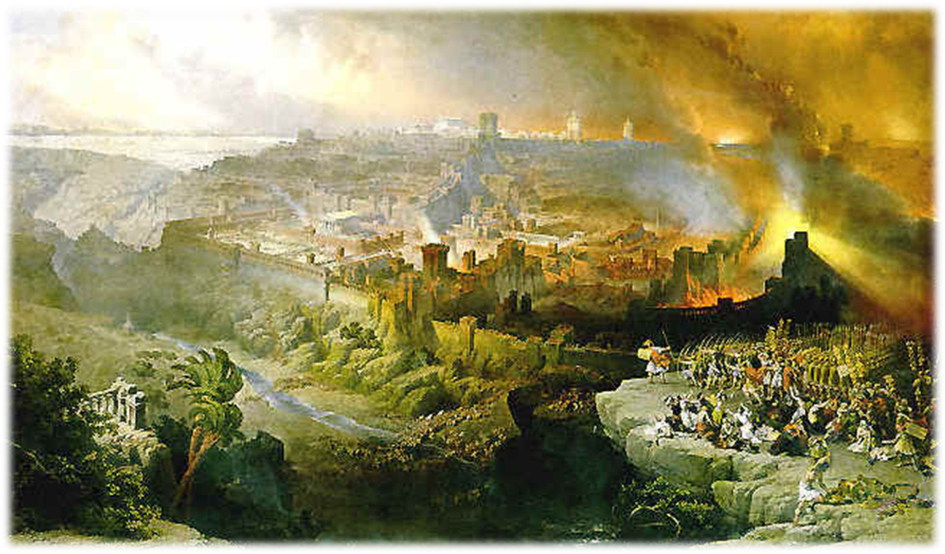
When God’s Kingdom Conquers
Global Holocaust
Jerusalem at the Center
Israel will fall by the edge of the sword, and will be led captive into all the nations; and Jerusalem will be trampled under foot by the Gentiles until the times of the Gentiles are fulfilled. Luke 21:24
70 AD
1967
Notes:
** JC Lays Out TIMELINE..
70ad Begins, 1967 Ends

Slide 28
When God’s Kingdom Conquers
Global Holocaust
Jerusalem at the Center
Israel Invaded
“Remotest…north”
Iran, Libya, African Nations
“I will take you up from the remotest parts of the north and bring you against the mountains of Israel…I will give you as food to every kind of predatory bird and beast of the field.”
Ezekiel 39:2,4

Slide 29
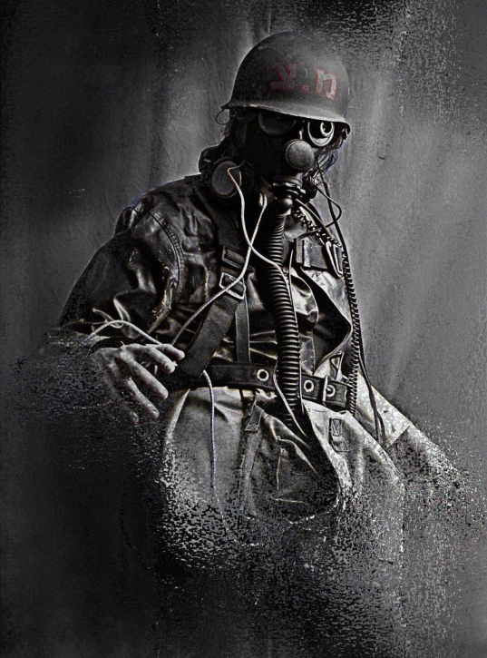
When God’s Kingdom Conquers
Global Holocaust
Jerusalem at the Center
Israel Invaded
“Remotest…north”
Iran, Libya, African Nations
Cataclysmic Destruction
“I will take you up from the remotest parts of the north and bring you against the mountains of Israel…I will give you as food to every kind of predatory bird and beast of the field.”
Ezekiel 39:2,4
"They will set apart men who will constantly pass through the land, burying those left on the surface of the ground, in order to cleanse it…if anyone sees a man's bone, then he will set up a marker by it until the buriers have buried it. Ezekiel 39:14-15

Slide 30
When God’s Kingdom Conquers
Global Holocaust
Jerusalem at the Center
Israel Invaded
“Remotest…north”
Iran, Libya, African Nations
Cataclysmic Destruction
I will gather all the nations against Jerusalem to battle…
Now this will be the plague with which the LORD will strike all the peoples who have gone to war against Jerusalem; their flesh will rot while they stand on their feet, and their eyes will rot in their sockets, and their tongue will rot in their mouth. Zechariah 14:1-2,12
Ezekiel 39:17-18 Thus says the Lord GOD, “Speak to every kind of bird and to every beast of the field: ‘Assemble and come! Gather from every side on the mountains of Israel, so you can eat flesh and drink blood. You will eat the flesh of mighty men and drink the blood of the princes of the earth, as though they were rams, lambs, goats and bulls…’”
And the four angels, who had been prepared for the hour and day and month and year, were released, so that they would kill a third of mankind. The number of the armies of the horsemen was two hundred million; I heard the number of them. Revelation 9:15-16

Slide 31
When God’s Kingdom Conquers
Global Holocaust
Jerusalem at the Center
Israel Invaded
“Remotest…north”
Iran, Libya, African Nations
Cataclysmic Destruction
I will gather all the nations against Jerusalem to battle…
Now this will be the plague with which the LORD will strike all the peoples who have gone to war against Jerusalem; their flesh will rot while they stand on their feet, and their eyes will rot in their sockets, and their tongue will rot in their mouth. Zechariah 14:1-2,12
Ezekiel 39:17-18 Thus says the Lord GOD, “Speak to every kind of bird and to every beast of the field: ‘Assemble and come! Gather from every side on the mountains of Israel, so you can eat flesh and drink blood. You will eat the flesh of mighty men and drink the blood of the princes of the earth, as though they were rams, lambs, goats and bulls…’”
And the four angels, who had been prepared for the hour and day and month and year, were released, so that they would kill a third of mankind. The number of the armies of the horsemen was two hundred million; I heard the number of them. Revelation 9:15-16

Slide 32
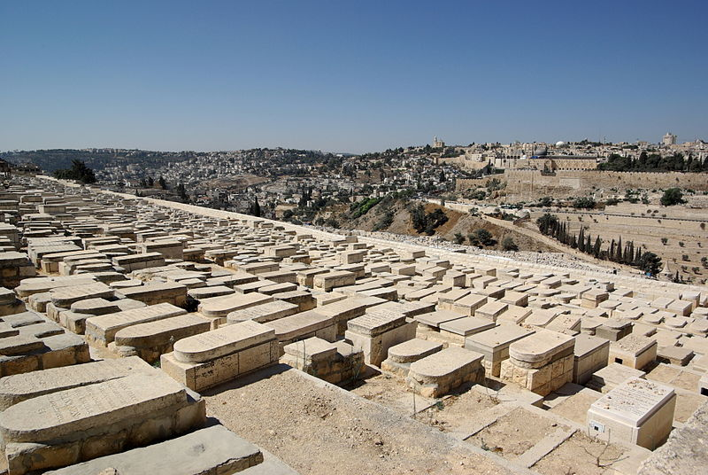
The “Olivette Discourse”
Overlooking Jerusalem
God’s Beachhead
His Kingdom launched
His Kingdom established
(i.e., the end of human kingdoms)

